Slide 1


Huazhong University of Science and Technology
The Department of Electronics and Information Engineering
Electronic Circuit Analysis and Design
Analysis and Design
Dr. Tianping Deng
Email: dengtp@hust.edu.cn

Slide 2
Contents
PART 1 SEMICONDUCTOR DEVICES AND BASIC APPLICATIONS
Chapter 1 Semiconductor Materials and Diodes
Chapter 2 Diode Circuits
Chapter 3 The Field-Effect Transistor
Chapter 4 Basic FET Amplifiers
Chapter 5 The Bipolar Junction Transistor
Chapter 6 Basic BJT Amplifiers
Chapter 7 Frequency Response
Chapter 8 Output Stages and Power Amplifiers
PART 2 ANALOG ELECTRONICS
Chapter 9 Ideal Operational Amplifiers and Op-Amp Circuits
Chapter 10 Integrated Circuit Biasing and Active Loads
Chapter 11 Differential and Multistage Amplifiers
Chapter 12 Feedback and Stability
Chapter 13 Operational Amplifier Circuits
Chapter 14 Nonideal Effects in Operational Amplifier Circuits
Chapter 15 Applications and Design of Integrated Circuits
Chapter 1 Semiconductor Materials and Diodes

Slide 3
Ch1. Semiconductor Materials and Diodes
1.1 Semiconductor Materials and Properties
1.2 The PN Junction
1.3 Diode Circuits DC Analysis and Models
1.4 Diode Circuits AC Equivalent Circuit
1.5 Other Diode Types
1.6 Design Application: Diode Thermometer
1.7 Summary

Slide 4
1.1 Semiconductor Materials and Properties
1.1.1 Intrinsic Semiconductor
1.1.2. Extrinsic Semiconductor
N-type semiconductor
P-type semiconductor

Slide 5
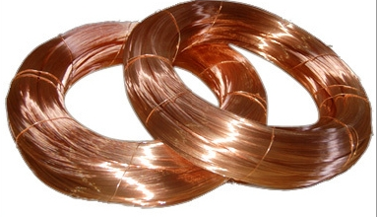

Ch1. Semiconductor Materials and Diodes
1.1 Semiconductor Materials and Properties
1.1.1. Intrinsic Semiconductor（P8)
Materials
electric current can flow freely
Conductor
Insulator
Semiconductor
:Low resistivity
Metals such as copper
:High resistivity
Glass, plastics, ceramics
: silicon, germanium, gallium arsenide
砷化镓
Conductivity lies between that of conductors and insulators
An integrated circuit (IC) or other electronic component
containing a semiconductor as a base material.

Slide 6

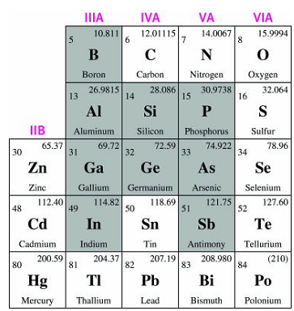





P8 T1.1
Silicon Valley
Periodic Table of the Elements

Slide 7
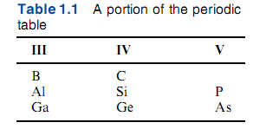
Periodic Table of the Elements

Slide 8


Slide 9
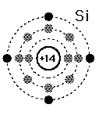
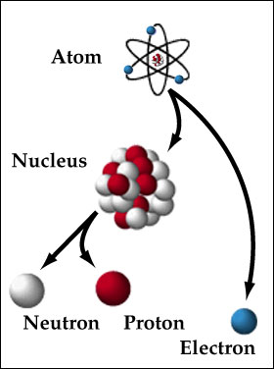
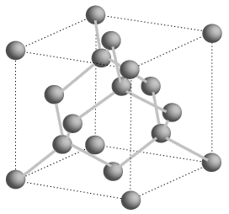
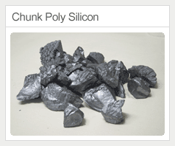
1.1.1 Intrinsic Semiconductor
1. Silicon, germanium__single-crystal structure
At temperature T=0ºK, silicon is an insulator.
valence electrons
The electrons in the outermost shell
中子
质子

Slide 10
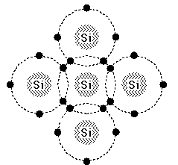


1.1.1 Intrinsic Semiconductor
Each S_{i} atom shares one
electron with each of its
four nearest neighbors
so that its valence band
will have a full 8 electrons.

Slide 11
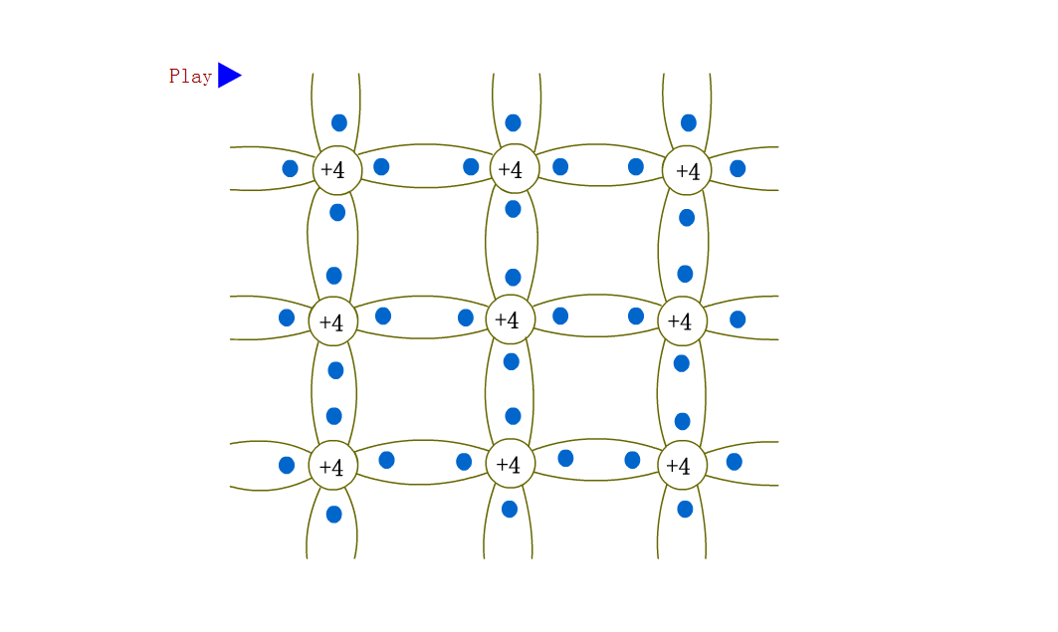
1.1.1 Intrinsic Semiconductor
When T increases, free electrons and “holes”are created

Slide 12
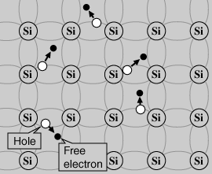
1.1.1 Intrinsic Semiconductor
浓度
In pure semiconductor, the concentration of electrons and holes are equal, and very small, so it has very small conductivity.
electron-hole pairs

Slide 13
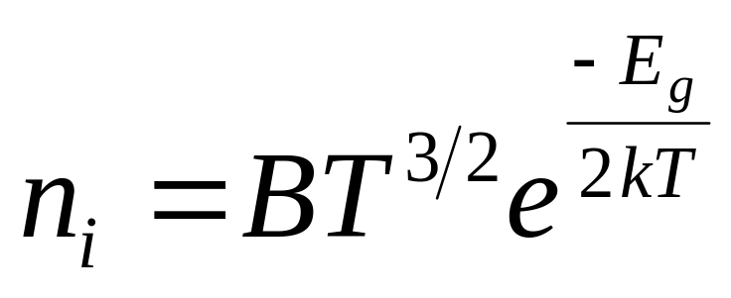
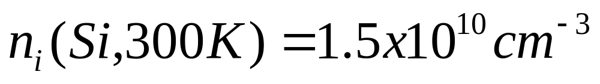
1.1.1 Intrinsic Semiconductor
Intrinsic Carrier Concentration（P10）
B – coefficient related to specific semiconductor
T – temperature in Kelvin
E_{g} – semiconductor band gap energy
k – Boltzmann constant

Slide 14






1.1.1 Intrinsic Semiconductor

Slide 15
Two types of Carriers
Free electron---
produced by thermal ionization.
It can move freely in the lattice structure so as to form current.
Hole---
empty position in broken covalent bond.
It can be filled by free electron
(recombination).
A free electron is negative charge and a hole is positive charge.

Slide 16

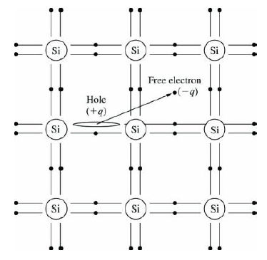
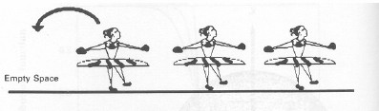

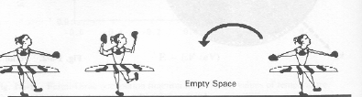


1.1.1 Intrinsic Semiconductor
Empty
space
Empty
space
Empty
space
Empty
space
A hole can be regarded as a positive charge carrier
Does the hole can move through the crystal freely?

Slide 17
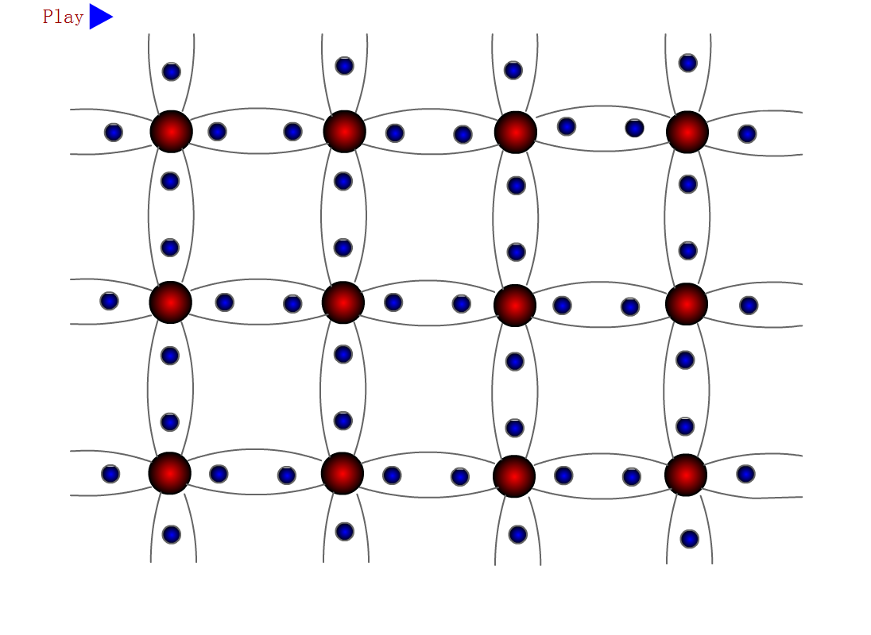

Slide 18

1.1.1 Intrinsic Semiconductor

Slide 19
1.1.2. Extrinsic Semiconductor
●The electron and hole concentrations in
an intrinsic semiconductor are relatively
small.
●The concentrations can be greatly
increased by adding controlled amounts
of certain impurities.
杂质

Slide 20
1.1.2. Extrinsic Semiconductor
Doped Semiconductor——n type
Si
Si
Si
施主
Donor
Free E
＋
P
Si
Si
Si
bound charge
Si
Si
Si
束缚电荷

Slide 21
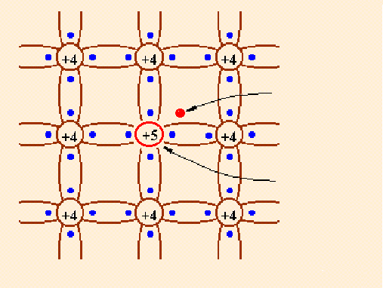
1.1.2. Extrinsic Semiconductor
1. phosphorus+silicon=N-type semiconductor
Holes present because of thermal energy
What are the majority carriers in n-type materials?
What are the minority carriers in n-type materials?
N-type semiconductor material
(phosphorus)
  donor: provide free electrons
  majority carrier – electrons
  minority carrier – holes
Redundant
electron
Donor Impurity
Positive charge
多数载流子：多子
N-type semiconductor
少数载流子：少子

Slide 22
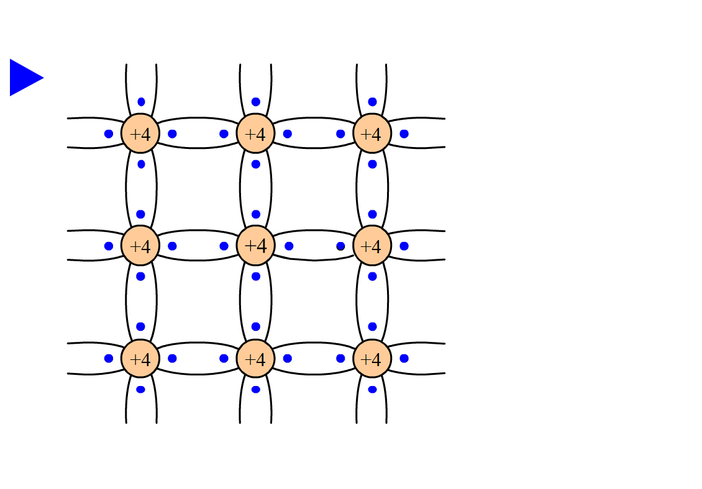

Slide 23
n type Semiconductor
五价
Donor--- pentavalent impurity provides free electrons, usually entirely ionized.
Positive bound charge---impurity atom donating electron gives rise to positive bound charge.
Majority carriers---free electrons (mostly generated by ionized donor and a very tiny portion by thermal ionization) .
Minority carriers---holes (only generated by thermal ionization) .
离子化

Slide 24
1.1.2. Extrinsic Semiconductor
Doped Semiconductor——p type
Si
Si
Si
受主
Acceptor
Si
Si
Al
Si
Al
––
Bound
charge
Si
Si
Si
Hole

Slide 25
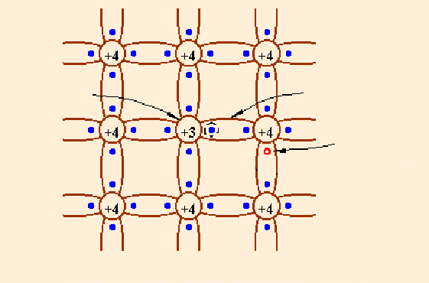
1.1.2. Extrinsic Semiconductor
2. boron+silicon=P-type semiconductor
What are the majority carriers in P-type materials?
What are the minority carriers in P-type materials?
Acceptor Impurity
Negative charge
Motion of holes
P-type semiconductor
material (Boron)
  acceptor: accept an extra electrons
  majority carrier – holes
  minority carrier – electrons
Hole
P-type semiconductor

Slide 26
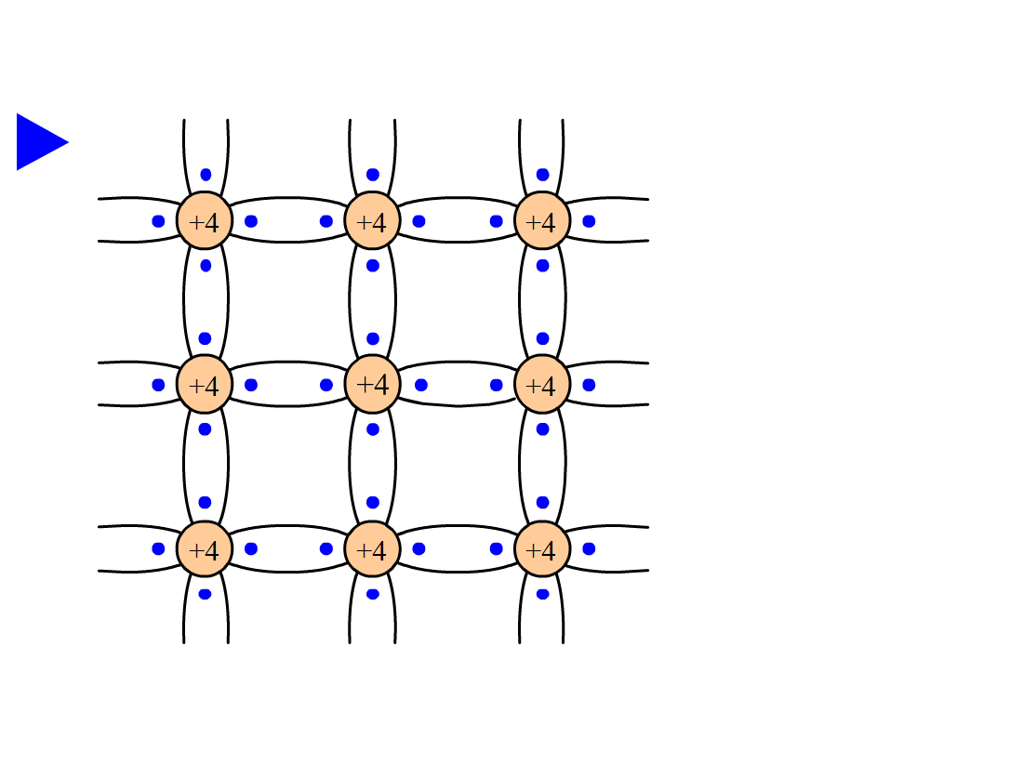

Slide 27
p type Semiconductor
三价
Acceptor--- trivalent impurity provides holes, usually entirely ionized.
Negative bound charge--- impurity atom accepting hole give rise to negative bound charge
Majority carriers---holes (mostly generated by ionized acceptor and a tiny small portion by thermal ionization)
Minority carriers--- free electrons (only generated by thermal ionization.)

Slide 28
1.1.2. Extrinsic Semiconductor
1. phosphorus+silicon=N-type semiconductor
Positive Charges + holes =electrons
minority carrier
majority carrier
Doping
Temperature
2. boron+silicon=P-type semiconductor
Negative Charges + electrons = holes
majority carrier
minority carrier
Temperature
Doping

Slide 29
Conclusion on the doped semiconductor
Majority carrier is only determined by the impurity, but independent of temperature.
Minority carrier is strongly affected by temperature.
杂质

Slide 30
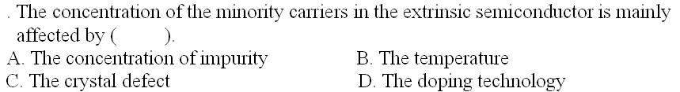


Slide 31
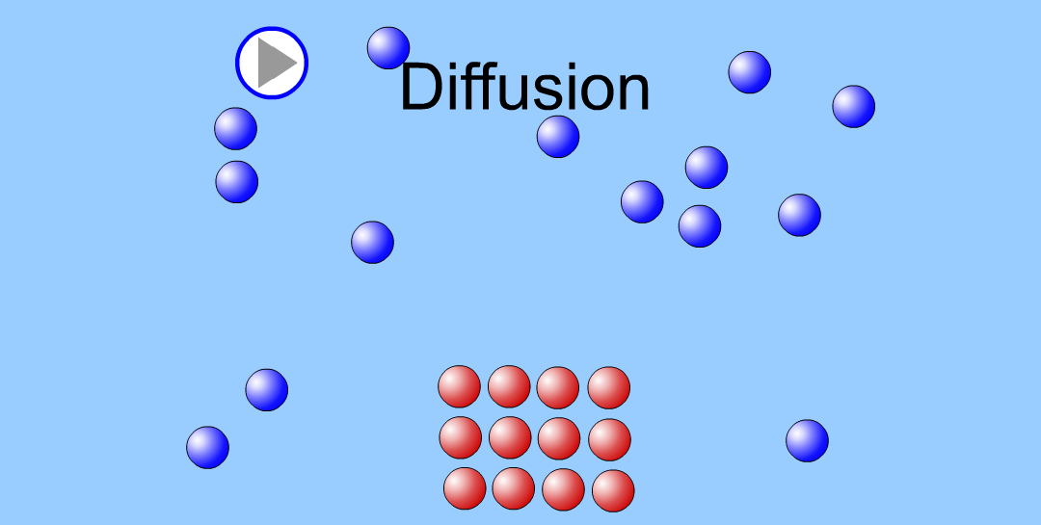
1.1.3. Drift and Diffusion Currents (P14)
Diffusion: a concentration of charge carriers
tends to spread with time
扩散

Slide 32
1.1.3. Drift and Diffusion Currents (P14)
Diffusion: a concentration of charge
carriers tends to spread with
time
Drift: The average motion of the charge
carriers due to an applied electric
field.
漂移

Slide 33
Questions
and
Answers

